Slide 1
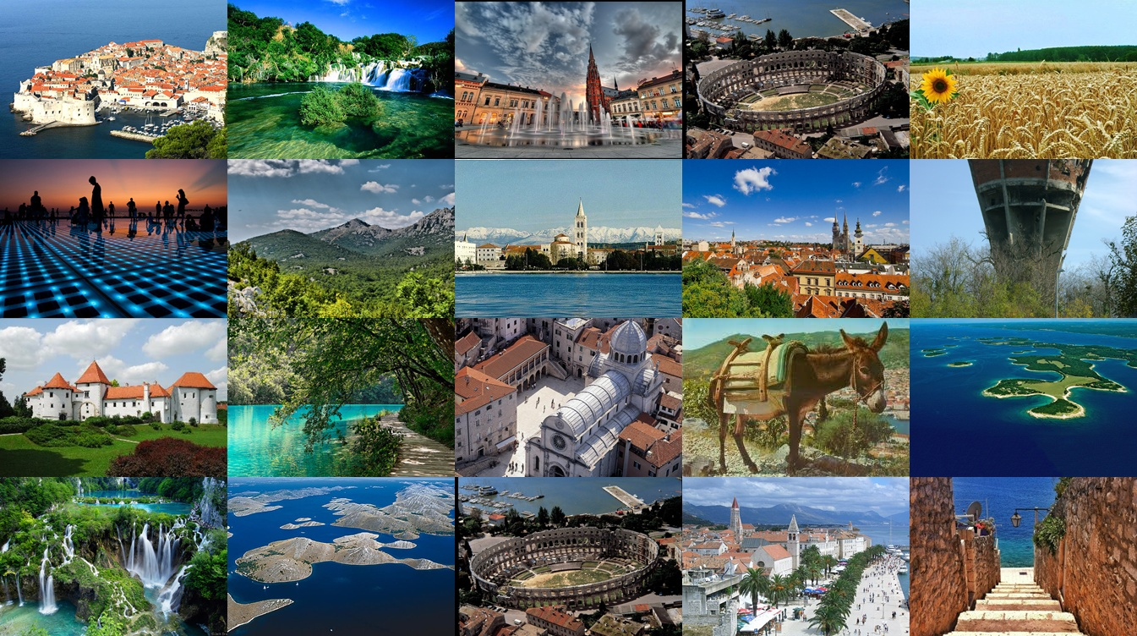
C R O A T I A

Slide 2
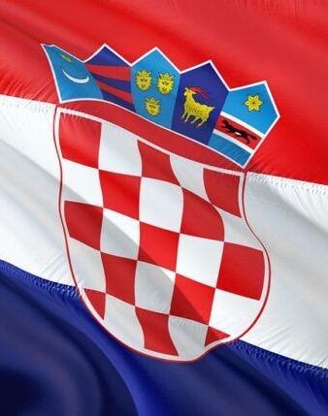
THE SYMBOLS OF CROATIA
The flag of the Republic of Croatia
The coat of arms of the Republic of Croatia - our historical coat of arms
The national anthem - Lijepa naša domovino

Slide 3
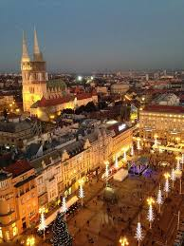
CAPITAL CITY
Zagreb is the capital of Croatia and the most populated city.

Slide 4
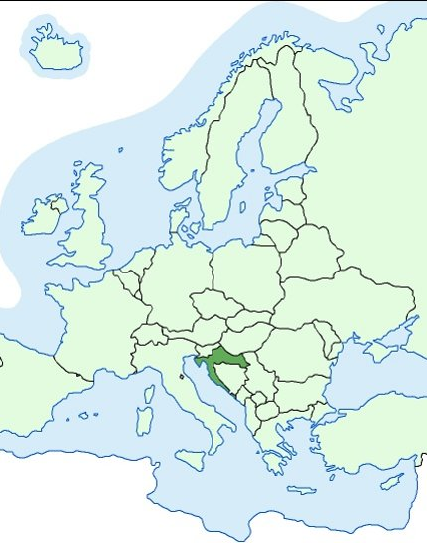
LOCATION
Located in the southern part of Central Europe and in the norhern part of the Mediterranean.
Slovenia and Hungary are bordering Croatia in north, Bosnia and Herzegovina, and Serbia in east, it has a short border with Montenegro, and it shares maritime borders with Italy.
It occupies an area of 56,594 km and has population of 3 899 000.

Slide 5
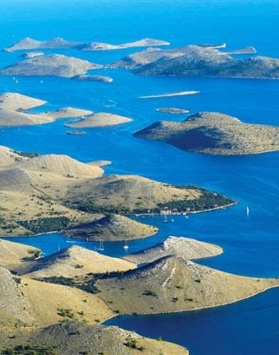
THE ADRIATIC SEA
Croatia is a small country located along the eastern side of the Adriatic coast.
It has an idented coast of thousands of islands.

Slide 6
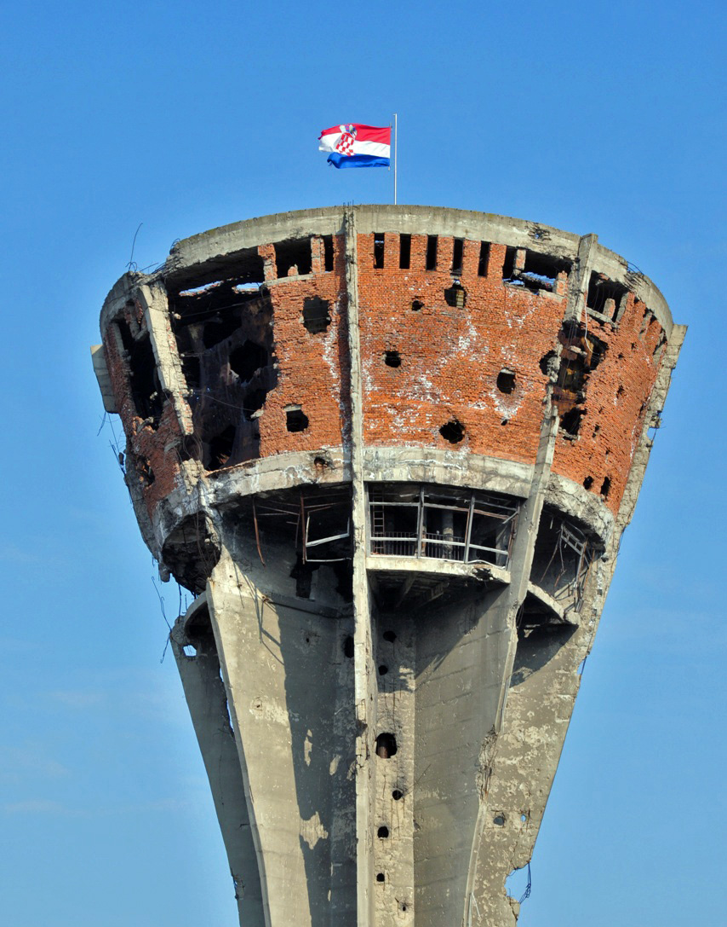
VUKOVAR
Croatian Parliament declared independence from Yugoslavia in June 1991.
Croatia was internationally recognised on 15th January 1992 by the European Union and subsequently the United Nations
The war ended with Croatian victory in Operation Storm in August 1995.
Vukovar is the symbol of the Croatian Homeland war and the the city monument of our strenght and endurance during war.

Slide 7
Interesting facts about Croatia

Slide 8
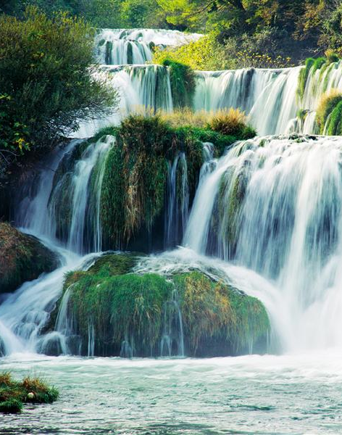
National parks
Croatia is one of the ecologically best preserved parts of Europe.

Slide 9
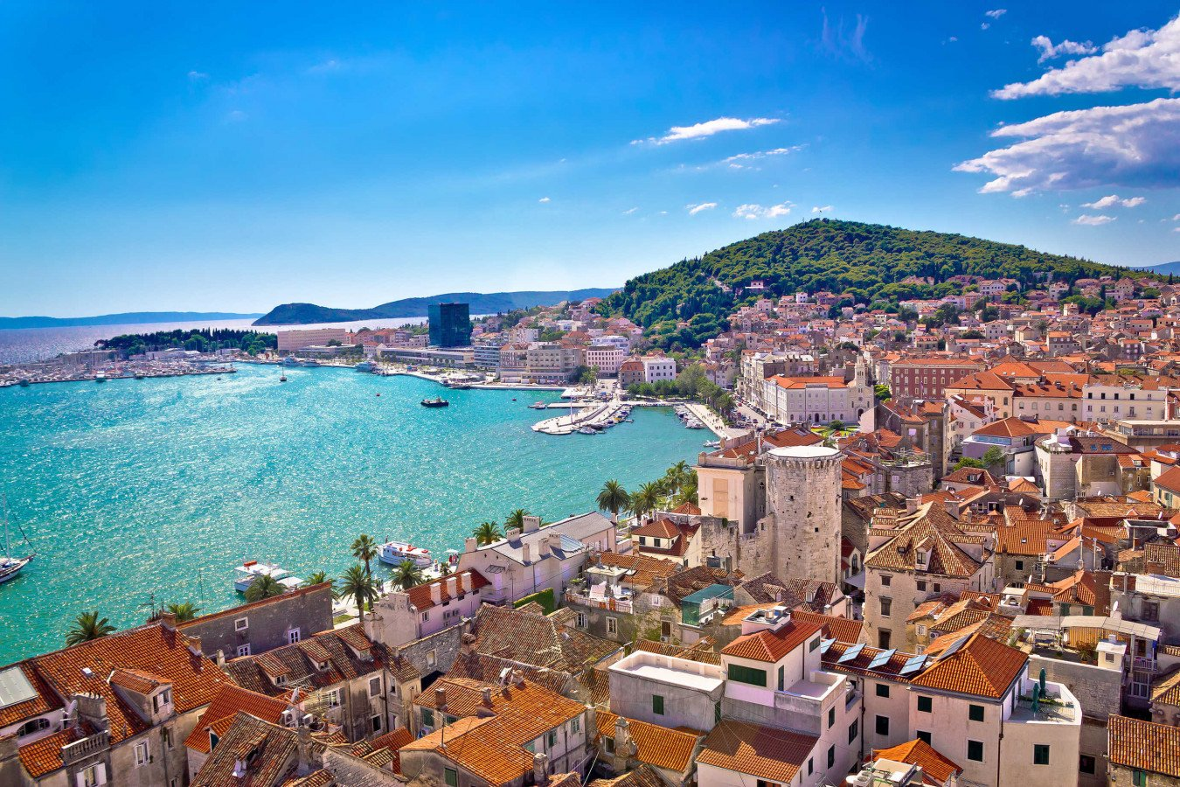
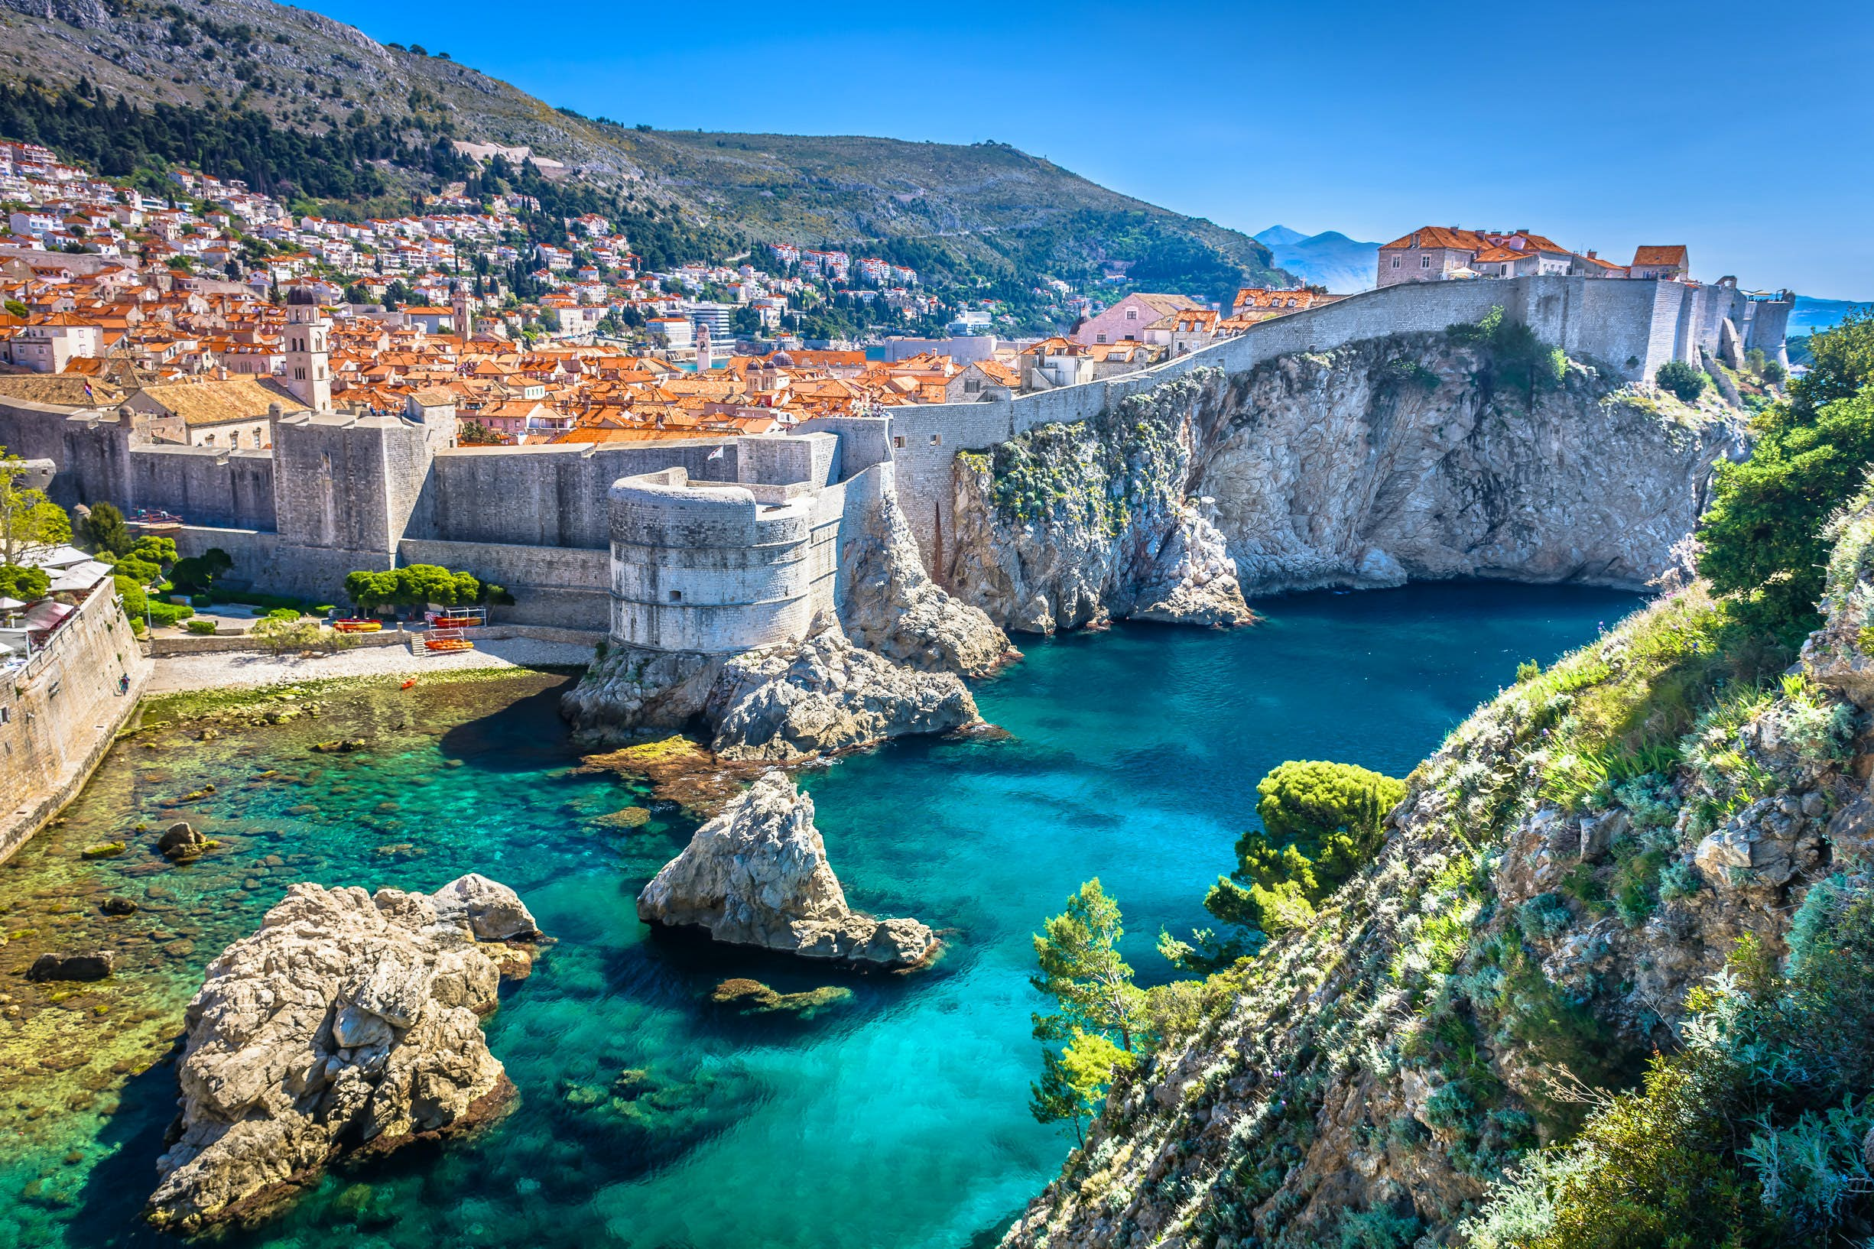
DUBROVNIK I SPLIT
Dubrovnik i Split are the most visited Croatian cities.

Slide 10
LUKA MODRIĆ
Luka Modrić – the most famous Croatian sportsman

Slide 11
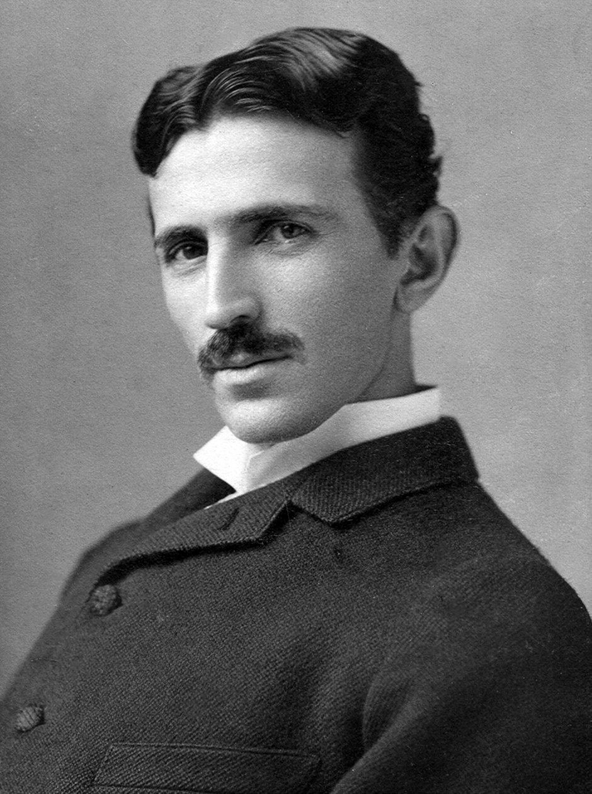
NIKOLA TESLA
Nikola Tesla – inventor, born in Croatia.

Slide 12
MATE RIMAC
Mate Rimac-innovator and enterpreneur, founder and director of the car company Rimac automobiles

Slide 13
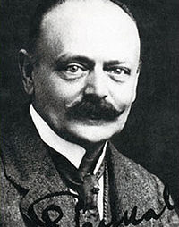
PEN
The first pen was invented by Eduard Slavoljub Penkala in 1906.

Slide 14
TIE
Tie originates from Croatia, today is worn all around the world.

Slide 15
DALMATINAC
Dalmatian is the dog that you are probably familiar with, but do you know that it originates from the region Dalmatia which gave its name.

Slide 16
THE END

