Slide 1
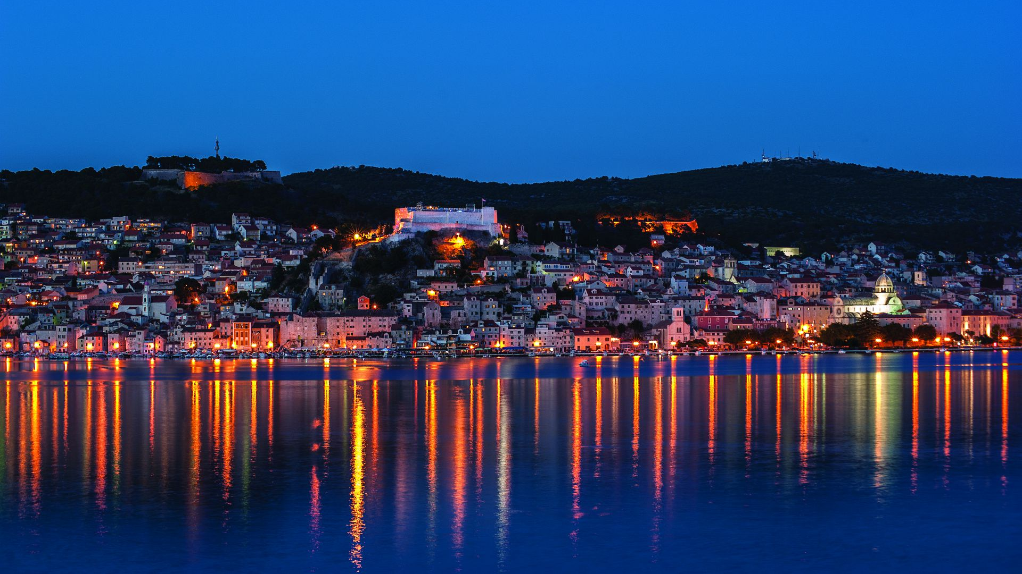
Šibenik
Lana Kalpić

Slide 2
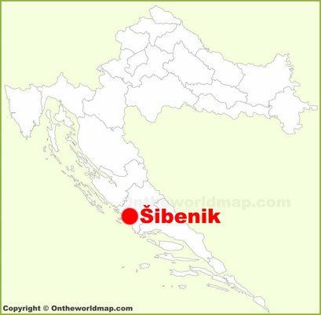
ABOUT ŠIBENIK
Šibenik is located in the central part of the Croatian Adriatic coast, at the mouth of the Krka River with the Adriatic Sea. It is the oldest native Croatian city on the Adriatic coast. Šibenik is the only city in Croatia and one of the few cities in the world with two monuments registered on the UNESCO list of protected cultural heritage.

Slide 3
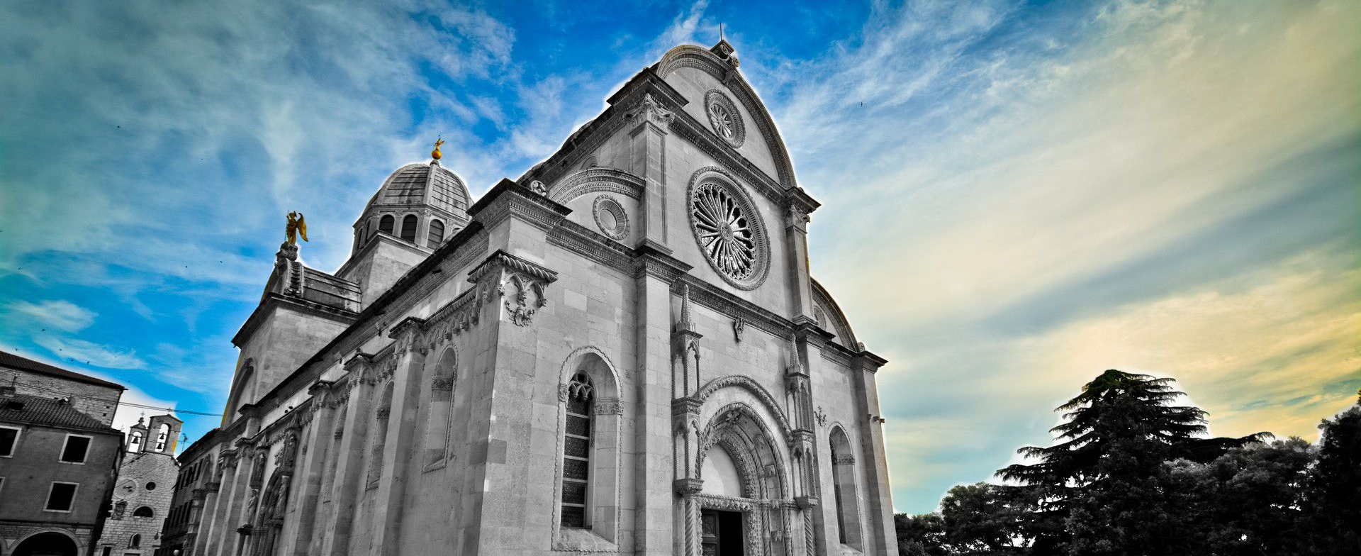
St. James's Cathedral
The Cathedral of St. James in Šibenik is one of the most beautiful architectural achievements in Croatia. In 2000, it was included in the UNESCO list of world cultural heritage. It was built over a hundred years, during the 15th and 16th centuries, and is unique in that it was completely built of stone.

Slide 4
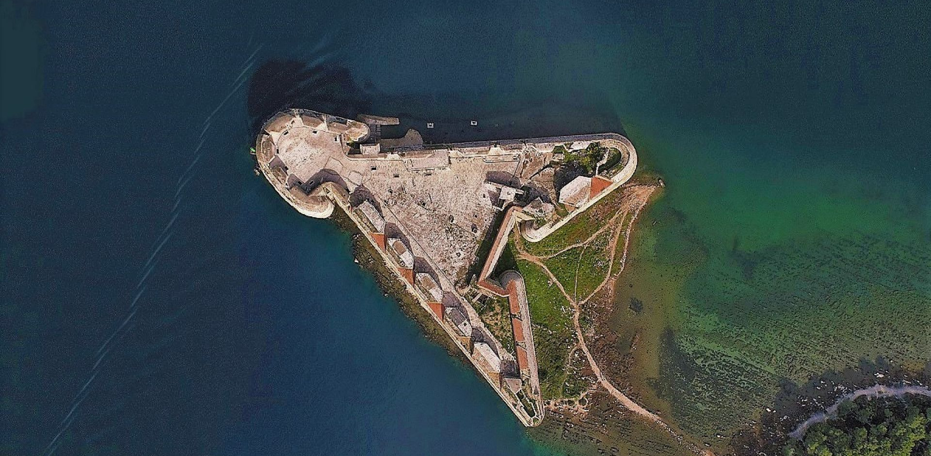
St. Nicholas Fortress
Šibenik is a city known for its numerous fortresses. In 2017, St. Nicholas Fortress was included in UNESCO's list of world cultural heritage. The fortress was built to protect the city of Šibenik from the sea in the 16th century Apart from it, the Barone, St. Mihovil and St. Ivan fortresses are more famous and used publicly.

Slide 5
Šibenik, the first in the world...
The interesting thing that connects us to the city of Šibenik is that it was the first city in the world that got public lightning on alternating electricity.
The Jaruga hydroelectric plant on the Krka river was put into operation two days later than the hydroelectric plant at Niagara Falls in the USA. The residents of Šibenik got the electricity the same day, and the residents of Buffalo only a year later, that is in 1896.

Slide 6
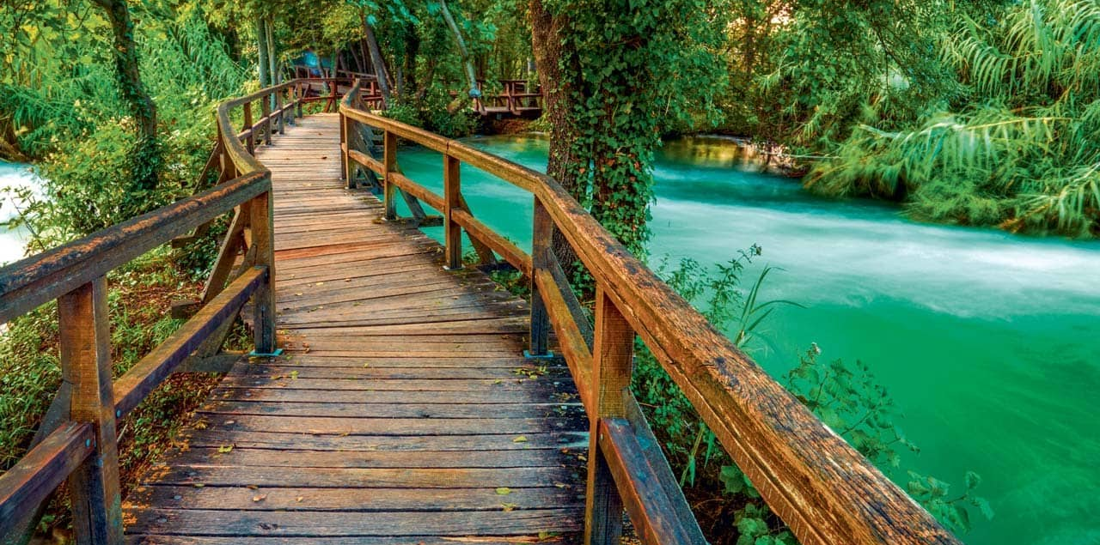
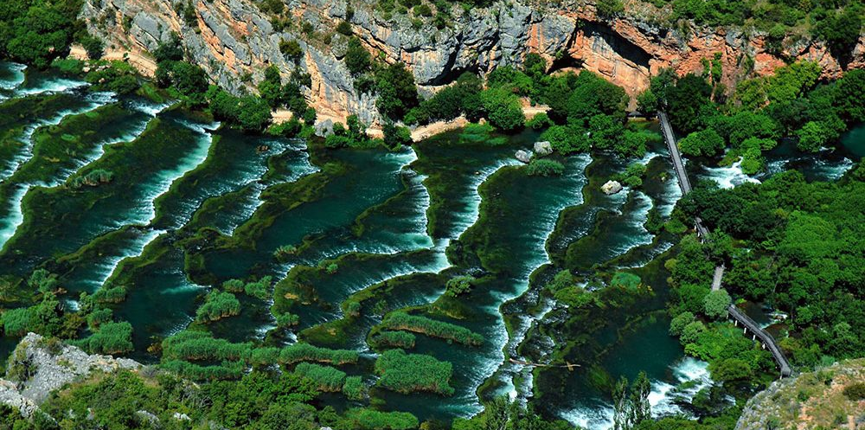
National park Krka
When we talk about the mouth of the Krka River, it is necessary to mention one of the most beautiful national parks, National park Krka. It was founded in 1985 and consists of seven beautiful waterfalls.

Slide 7
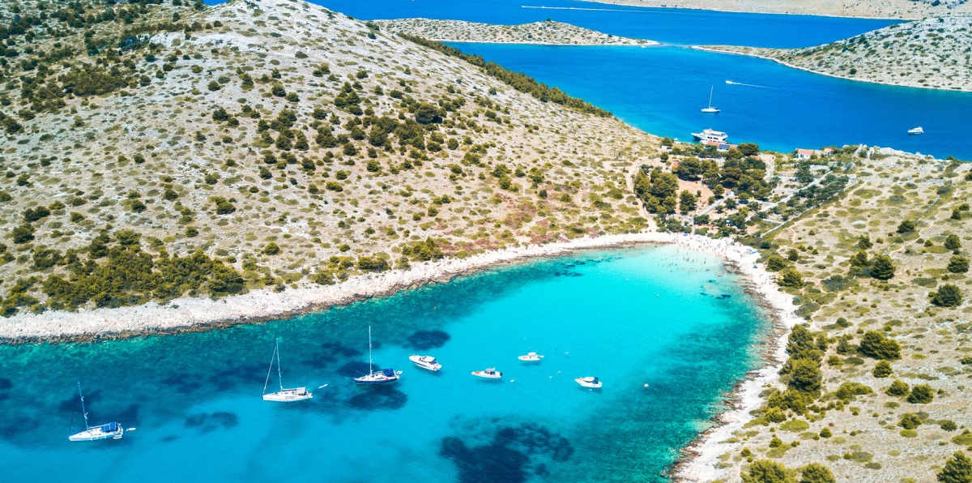
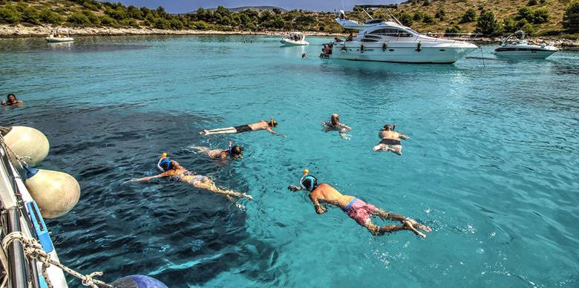
Kornati
The second national park in the Šibenik county
It was proclaimed national park in 1980 and it is proctected since then
It consists of 89 islands, islets and rocks
Out of the total area of 220 square km, land makes only 1/4 of the entire park

Slide 8
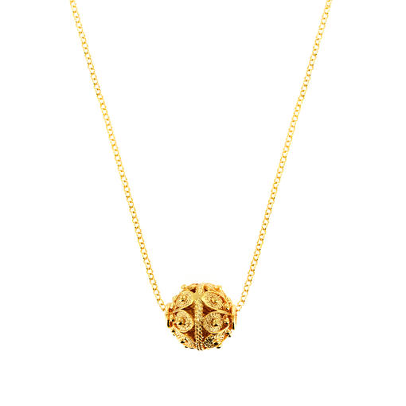
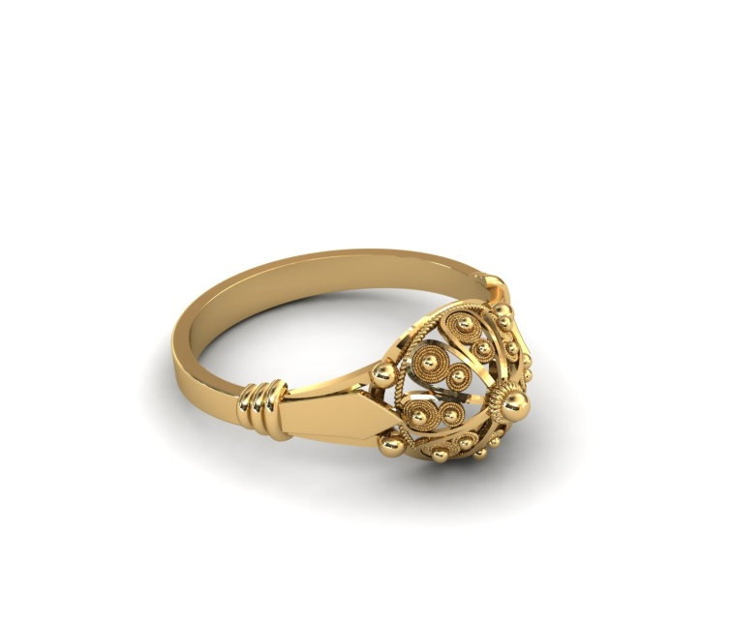
Šibenik's botun
Souvenir that connects you to the city of Šibenik is Šibenik's botun
In the past, it was the main detail on men's traditional costumes and today is part of the most authentic jewelry

Slide 9
Šibenik cap
The Šibenik cap is famous Croatian version of the red cap. Today it is usually orange with two rows of black embroidery. Today, it is the part of the Šibenik traditional folk costume.

Slide 10
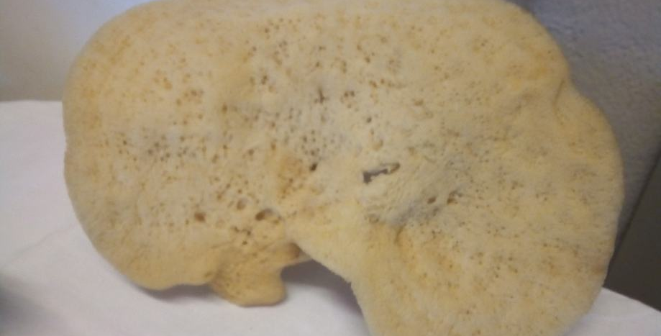
Sponges and corals
SPONGES
Sponges from the island of Krapanj are one of the most significant symbols of the city of Šibenik
In Krapanj, the tradition of sponging has been nurtured for centuries.
It is highly valued for its quality and beauty.
There are 5,000 species of sea sponges

Slide 11
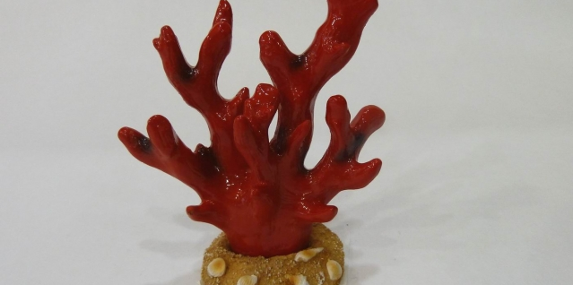
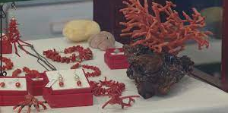
Sponges and corals
CORALS
Red coral from the island of Zlarin is the first association on that island.
It is believed in its healing powers except of its unique beauty.
It symbolizes love, devotion, faithfulness and submission.

Slide 12
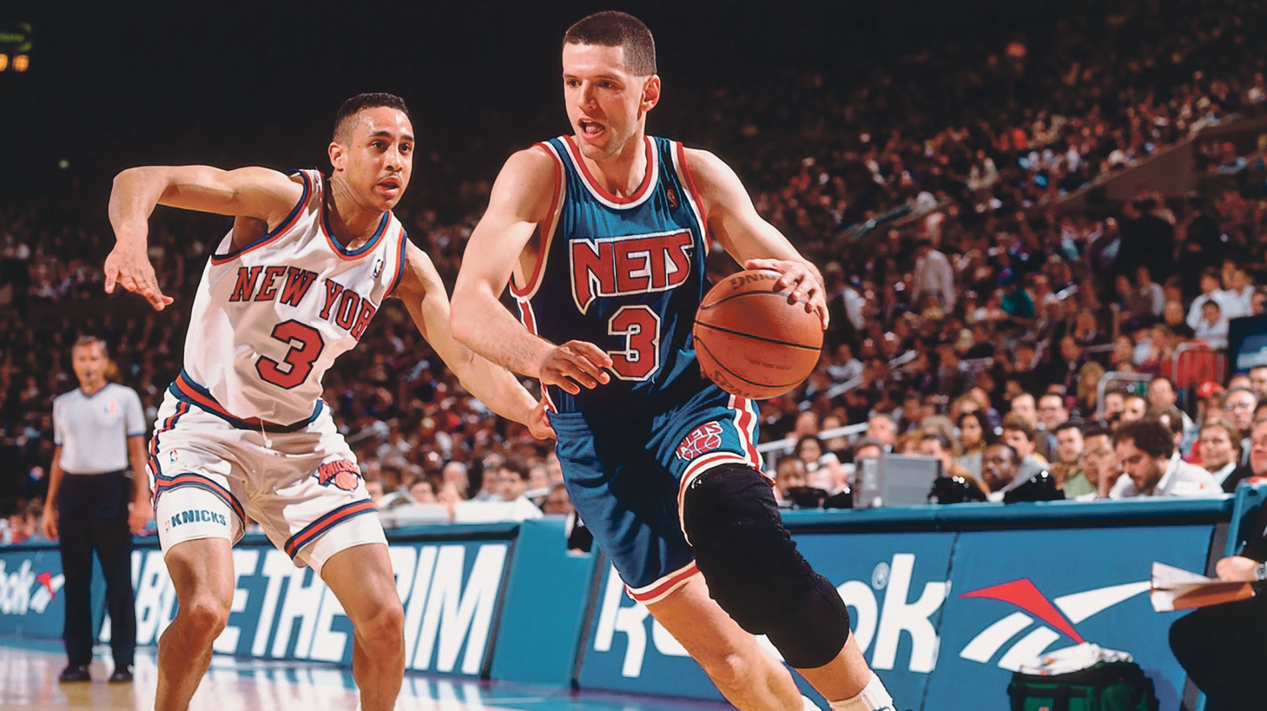
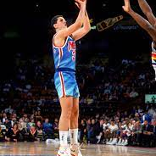
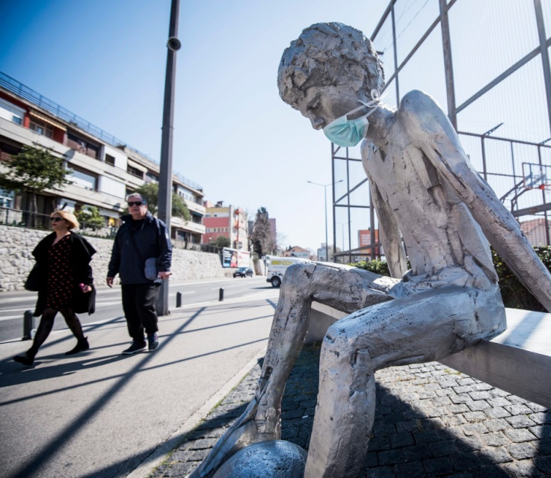
Dražen Petrović
Šibenik is also known as the city of Dražen Petrović. He was a Croatian and Yugoslavian professional basketball player born in Šibenik.
He achieved success playing professional basketball in Europe and in 1989 he joined the NBA.
His monument is located in Šibenik in front of Dražen Petrović's basketball court..

Slide 13
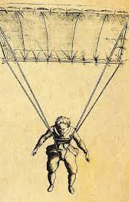
Faust Vrančić
Faust Vrančić is a world-famous linguist, engineer, diplomat , inventor, priest and bishop born in Šibenik.
We associate him with the invention of Homo Volans – the flying man, but Faust Vrančić invented much more than that.

Slide 14
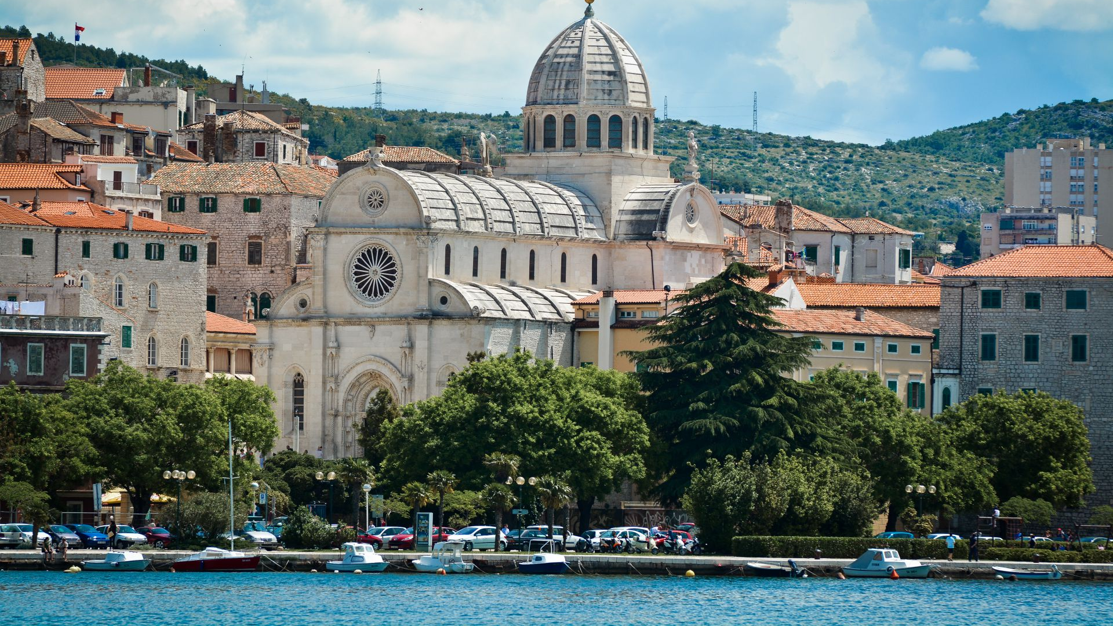
The end
Thank you for your attention

